Slide 1

Lic. en Sistemas
Inglés Nivel 1

Slide 2


Introducing yourself in English

Slide 3
#1 Let´s talk!
What´s your name? I´m Diego Dominguez
Where are you from? I´m from Argentina
What´s your contact number / WhatsApp number? It´s 11-4423-5870
What´s your email address? diego.dominguez@gmail.com
Where do you live? I live in Lomas de Zamora / I live in Argentina
Where do you work? I work in IBM / Google
What do you do? I´m a system analyst
Who do you work for? I work for IBM / Google
Do you like your job? Yes, I do / No, I don´t

Slide 4
What’s happening
How’s it going?
Good evening
How are you?
Nice to meet you!
Long time no see
What’s the good word?
What’s new?
Look who it is!
How have you been?
Nice to see you again.
Greetings and salutations!
How are you doing today?
What have you been up to?
How are you feeling today?
Good afternoon, sir, how are you today?
Ways of
Greeting

Slide 5
#1 Who you are
The very first step is to mention your name. This part is easy!
You can use the phrases below to introduce yourself:
I don’t think we’ve met (before).
I think we’ve already met.
My name is …
I’m …
Nice to meet you; I’m …
Pleased to meet you; I’m …
Let me introduce myself; I’m …
I’d like to introduce myself; I’m …
My name is Melanie, but you can call me Mel.

Slide 6
#2 What you do
When explaining what you do, don’t focus on tasks, focus on results. Introduce yourself with your key skills and major achievements.
I am a [job title] at [company].
Officially, my job is to…
But really, I…
It’s all about…
Which is a fancy way of saying…
Examples:
I’m a copywriter. Officially my job is to write content for advertising. But really, I
help companies tell compelling stories about their brands.
I am the COO, which is a fancy way of saying that I make sure that the company
is run in the most efficient way possible.

Slide 7
# 3 Let´s work
Grab a piece of paper and write down a few sentences using this framework.
Then, select the best introduction lines about yourself.
Here are some additional expressions to describe your roles and responsibilities:
I’m a [job] at [company].
I’m currently working as a [job].
I’ve been with [company] since [time] / for [period].
I work for [company].
I work in [field/industry].
I work with [department/person].
I’m self-employed. / I’m working as a freelancer. / I own my own company.
My role is…
My responsibilities include…
I’m responsible for…
I make sure that… / I ensure…
I oversee… / I supervise…
I handle…
I deal with…

Slide 8
# 3 Let´s work - example
I’m a Talent Acquisition manager. I’ve been working with Monsters Inc.
since 2012, and my responsibilities include finding, recruiting, hiring,
and retaining great candidates. It’s all about making sure the team
keeps growing nicely.

Slide 9
Present Simple (verb To Be)

Slide 10
Present Simple

Slide 11
Habits or actions that happen regularly
We use present simple for habits or actions that we repeat regularly:
I wash my hair every day.
I never go to the library.
I go to the library on Saturdays.
Permanent situations or things that are always or often true
I don’t drink coffee.
She’s very tall.
I have two brothers.
Water boils at 100 degrees.
I like soup.
When do we use it?

Slide 12
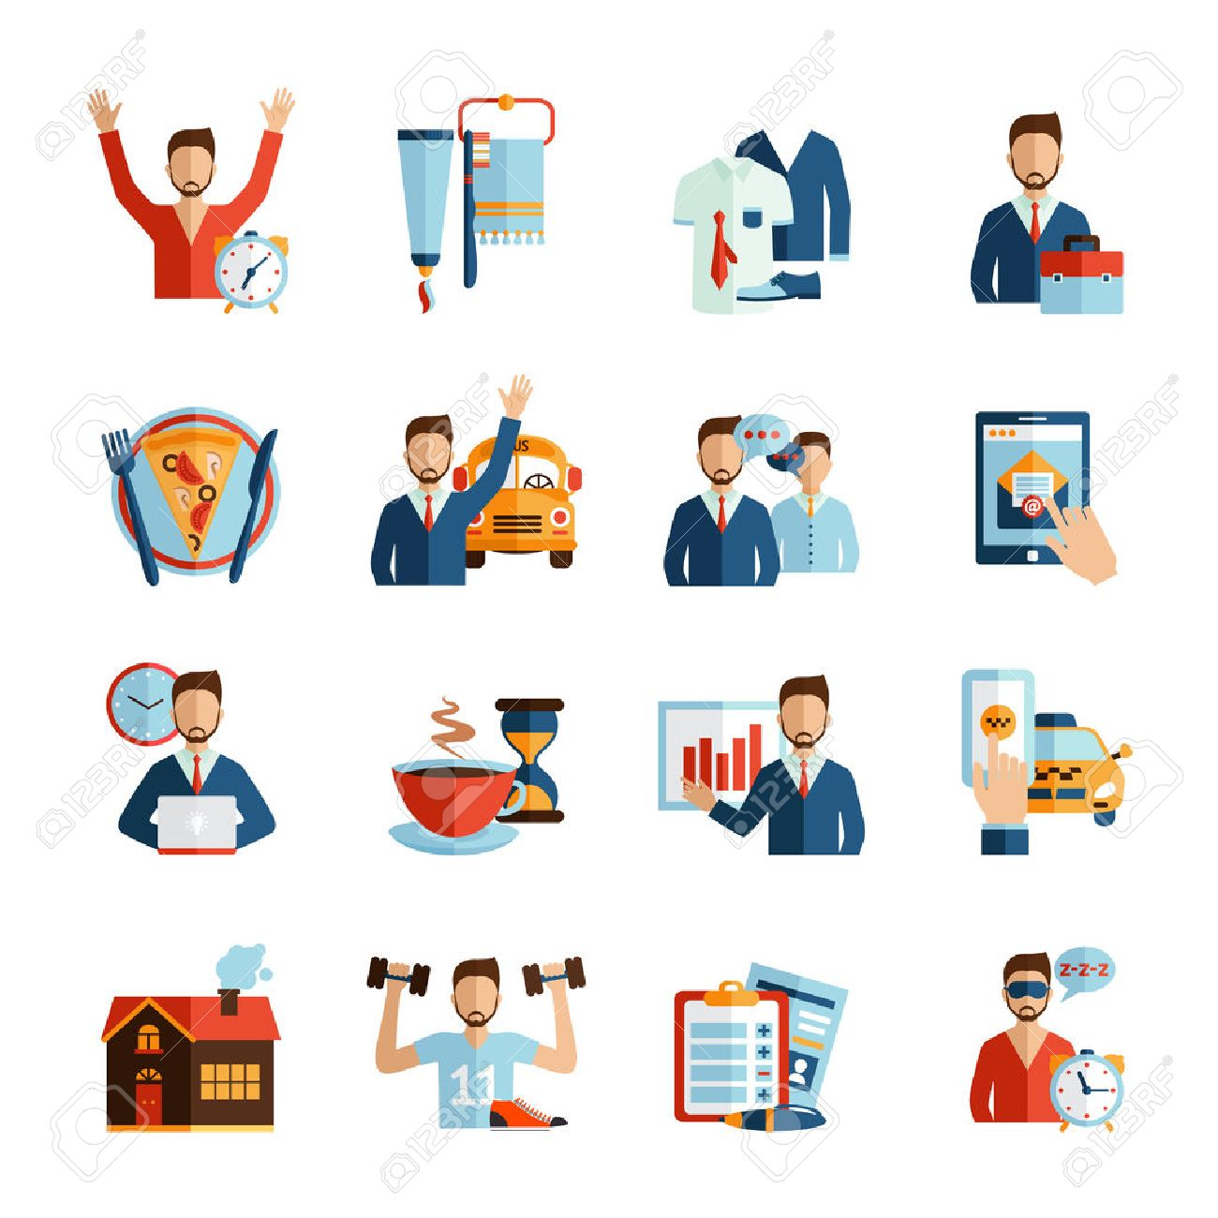

Slide 13
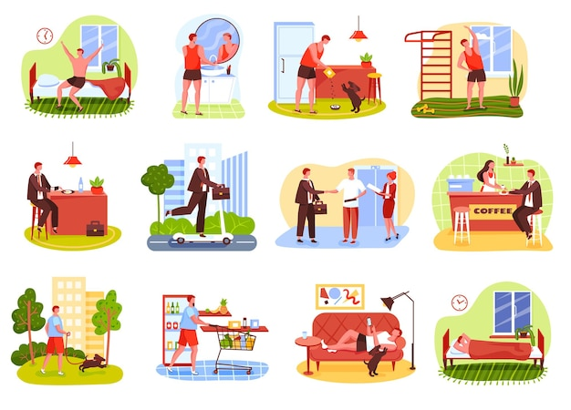

Slide 14
If you're beginning your career, establishing a successful routine can help you develop strong work habits and balance your professional and personal goals. Here's an example of a daily routine for an entry-level employee:
Wake up at the same time every morning
Journal for 15 minutes about personal or professional goals
Eat breakfast and get ready for work
Commute to work, if applicable
Read and respond to emails
Create a list of tasks for the day
Work on tasks
Take lunch
Go for a short walk after eating
Return to your desk and keep working on tasks
Daily Routines
for an entry-level employee
Check in with your manager about daily progress
Leave work and go home, if applicable
Work on hobbies for an hour
Eat dinner
Take a walk for 15 minutes
Read for 30 minutes
Go to sleep

Slide 15
As you advance in your career, you might spend more time doing professional development and earning certifications. By developing a routine, you can accomplish those tasks while meeting your basic work requirements and having a fulfilling personal life. Here's an example of a daily routine for a mid-level professional:
Wake up at the same time every morning
Go for a walk before breakfast
Eat breakfast and prepare for work
Commute, if applicable
Read emails and respond to correspondence
Review project plans and daily calendar
Work on projects
Take lunch
Review strategic goals with your manager
Complete project tasks for the day
Daily Routines
for a mid-level employee
Commute home, if applicable
Work on certification class for one hour
Eat dinner
Spend an hour on hobbies
Go to sleep

Slide 16
As a senior professional, you might have more varied responsibilities than entry- or mid-level professionals, who might learn the skills of their trade through repetition. While your duties might vary, you can still create a routine that balances your professional and personal priorities. Here's an example of a daily routine for a senior professional, like a manager or director:
Wake up at a regular time
Meditate or stretch for 10 minutes
Eat breakfast and get ready for work
Commute, if applicable
Read email and respond to messages
Meet with junior team members to discuss daily or
weekly assignments
Read project reports from team managers
Meet with other directors to review key performance
indicators (KPIs – Key Performance Indicator)
Attend lunch meetings with stakeholders
Read proposals for new projects
Daily Routines
for a senior professional
Meet with individual team members for training sessions or performance reviews
Commute home, if applicable
Spend time with family or friends
Exercise for 30 minutes
Eat dinner
Read for an hour
Go to sleep

Slide 17
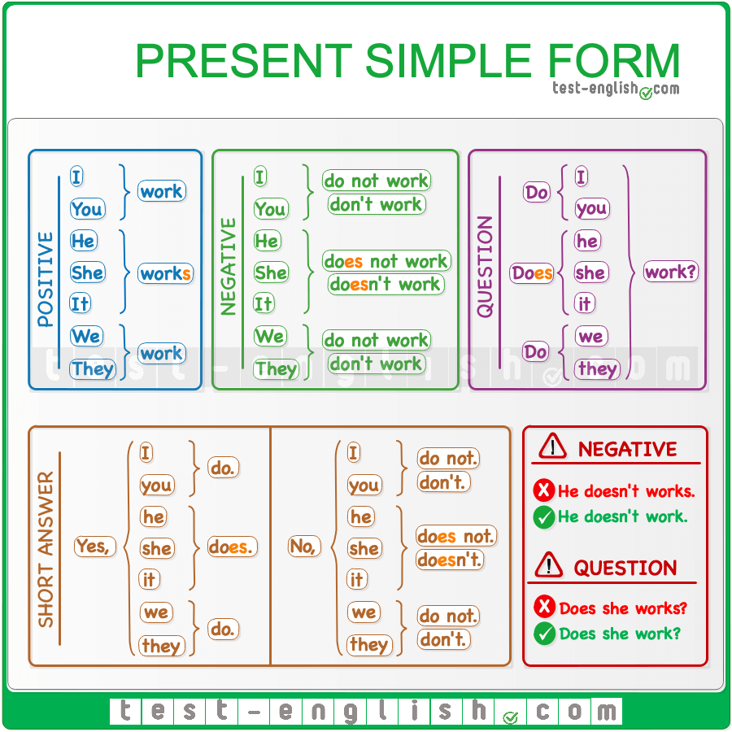

Slide 18
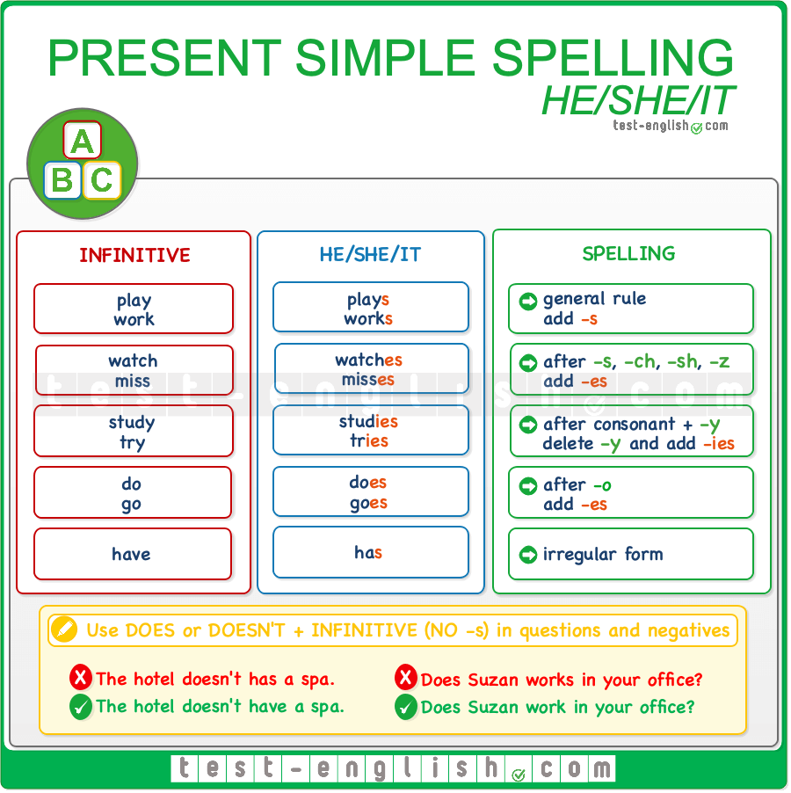

Slide 19
https://test-english.com/grammar-points/a1/present-simple/
https://www.english-room.com/grammar/presentsimpletense_affirmative_3.htm
https://www.english-room.com/grammar/presentsimpletense_1.htm
https://www.english-room.com/grammar/presentsimple_1.htm
https://www.english-room.com/grammar/presentsimple_mc_01.htm
Online Practice

Slide 20
Adverbs of Frequency

Slide 21
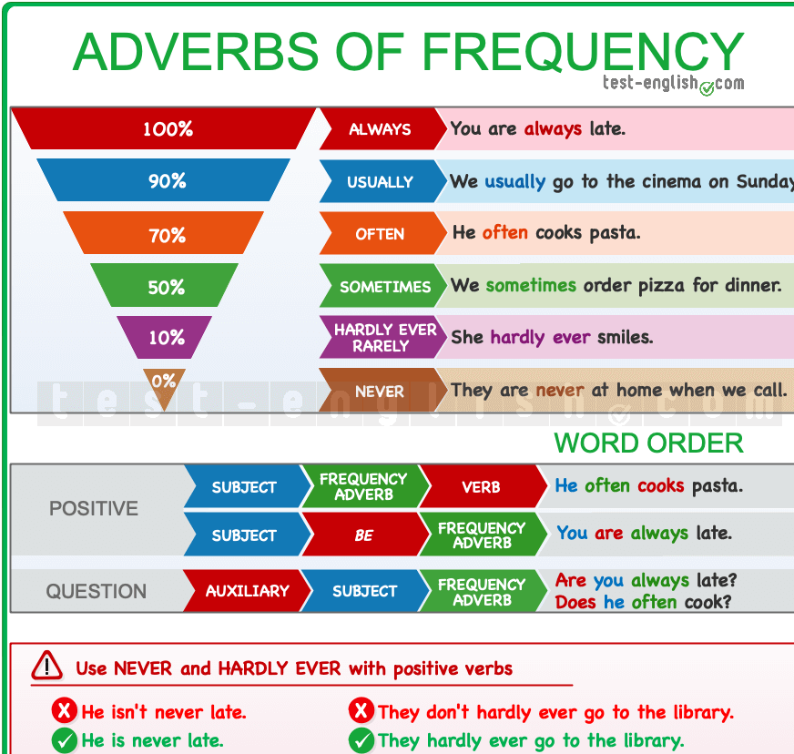

Slide 22
Position
Adverbs of frequency go before the verb but after the verb be.
In negative sentences, the adverb of frequency goes after don’t/doesn’t:
We don’t often go to bed late.
He doesn’t always agree with me.
In questions, adverbs of frequency go after the subject.
Is he always late?
Do they often go to the library?
.

Slide 23
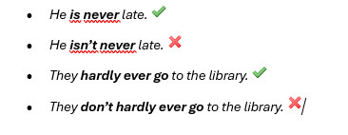
Never/hardly ever
The adverbs never and hardly ever (=almost never) have a negative meaning, but they are used with a positive verb:
.

Slide 24
Expressions of frequency
There are other expressions that we use to talk about frequency:
once a day, twice a week, three times a month, every day, etc.
These expressions are longer (2 words or more), and they go
at the end of the sentence.
I brush my teeth three times a day.
I see her every day.

